Slide 1
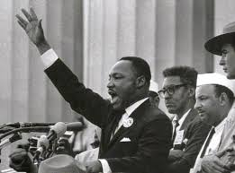
BAYARD RUSTIN’S ACTIVISM
from CIVIL RIGHTS to GAY RIGHTS
Dr. Martin Luther King Jr., The March on Washington for Jobs and Freedom
August 28, 1963. Bayard Rustin is to Dr. King’s immediate right, above.
By
Steven S. Berizzi
Professor, History & Political Science
Norwalk Community College

Slide 2
Race in the United States: Background
In 1865, after nearly 250 years of slavery in the United States, and a few months after the end of the Civil War, the Thirteenth Amendment to the Constitution abolished slavery in the U.S, and four million enslaved people were officially free. It was one of the most remarkable, revolutionary events in American history.
However, in 1935, Dr. W.E.B. DuBois, the greatest Black intellectual of the first half of the 20th century, remarked: “The slave went free, stood a brief moment in the sun, and then moved back toward slavery.” The emergence of racial segregation through what were known as “Jim Crow” laws in the South and other states, created a society that was little better than slavery.
The Civil Rights Movement of the 1950s and 1960s was led by brave people, mostly Black, who challenged the systemically racist order. Dr. Martin Luther King Jr. was the most famous of those leaders until he was assassinated in 1968. At his side almost every step was activist Bayard Rustin. This presentation provides an overview of his story.

Slide 3
Highlights of the Civil Rights Movement in the 1960s
Black college students protesting segregated lunch counters in the South founded the Student Non-Violent Coordinating Committee
Freedom Riders demanded integration of interstate travel services and facilities in the South
President John Kennedy called for “affirmative action” as a necessary remedy for past discrimination, especially in federal hiring and contracting
James Meredith, a Black veteran, attempted to enroll at the University of Mississippi. When White mobs rioted, Pres. Kennedy mobilized the state’s National Guard to protect Meredith, and Kennedy sent 5,000 federal troops to restore order.
Segregationist Democrat George Wallace was elected governor of Alabama
In June, after Gov. Wallace tried to prevent Black students from integrating the University of Alabama, Pres. Kennedy sent Justice Department officials and federal troops to confront Wallace, and he backed down.
In August, during the March on Washington for Jobs and Freedom, 250,000 people heard Dr. Martin Luther King Jr.’s “I Have a Dream” speech.

Slide 4
The Civil Rights Movement in the 1960s
A few months after Kennedy’s assassination, Congress passed and Pres. Lyndon Johnson signed into law the Civil Rights Act, the most far-reaching piece of federal civil rights legislation since the end of Reconstruction
Congress passed the Economic Opportunity Act, beginning what became known as the “war on poverty”
1965 Black nationalist leader Malcolm X was assassinated in New York City
Congress passed, and Pres. Johnson signed into law, the Voting Rights Act
1967 Thurgood Marshall, who had successfully argued Brown v. Board of Education (1954), was nominated to the Supreme Court by Pres. Johnson and confirmed by the Senate, becoming the first Black justice
Dr. King was assassinated in Memphis, Tennessee
Principal Source
Isserman, Maurice & Michael Kazin, “Critical Events During the Long 1960s,” America Divided: The Civil War of the 1960s (Oxford University Press, 2000)

Slide 5
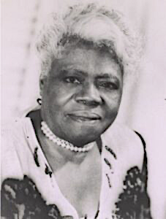
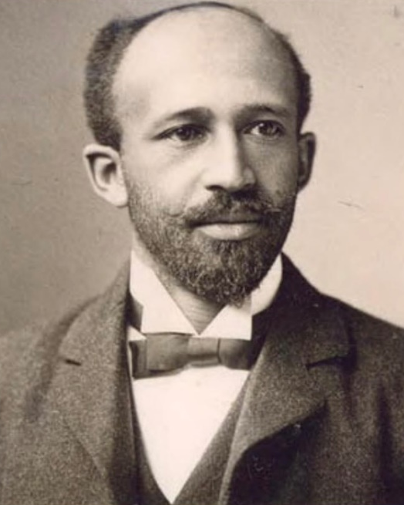
Bayard Rustin’s Roots
Every person is a product of his or her time and surroundings, especially family. Bayard Rustin later explained: “My activism did not spring from my being gay, or, for that matter, from my being black. Rather, it is rooted fundamentally in my Quaker upbringing, and the values that were instilled in me by my grandparents who reared me.
Rustin was born in 1912, one of 12 children raised by his grandparents in West Chester, Pennsylvania, a few miles west of Philadelphia. Rustin’s life-long commitment to nonviolence began with his Quaker upbringing and the influence of his grandmother, whose support for the National Association for the Advancement of Colored
Mary McLeod Bethune
pioneering educator & civil rights activist
People resulted in leaders of the Black community such as W. E. B. Du Bois and Mary McLeod Bethune visiting the Rustin home during Bayard’s childhood.
W. E. B. Du Bois
Harpers Ferry, W VA, 1907
DuBois Collection; University of Massachusetts

Slide 6
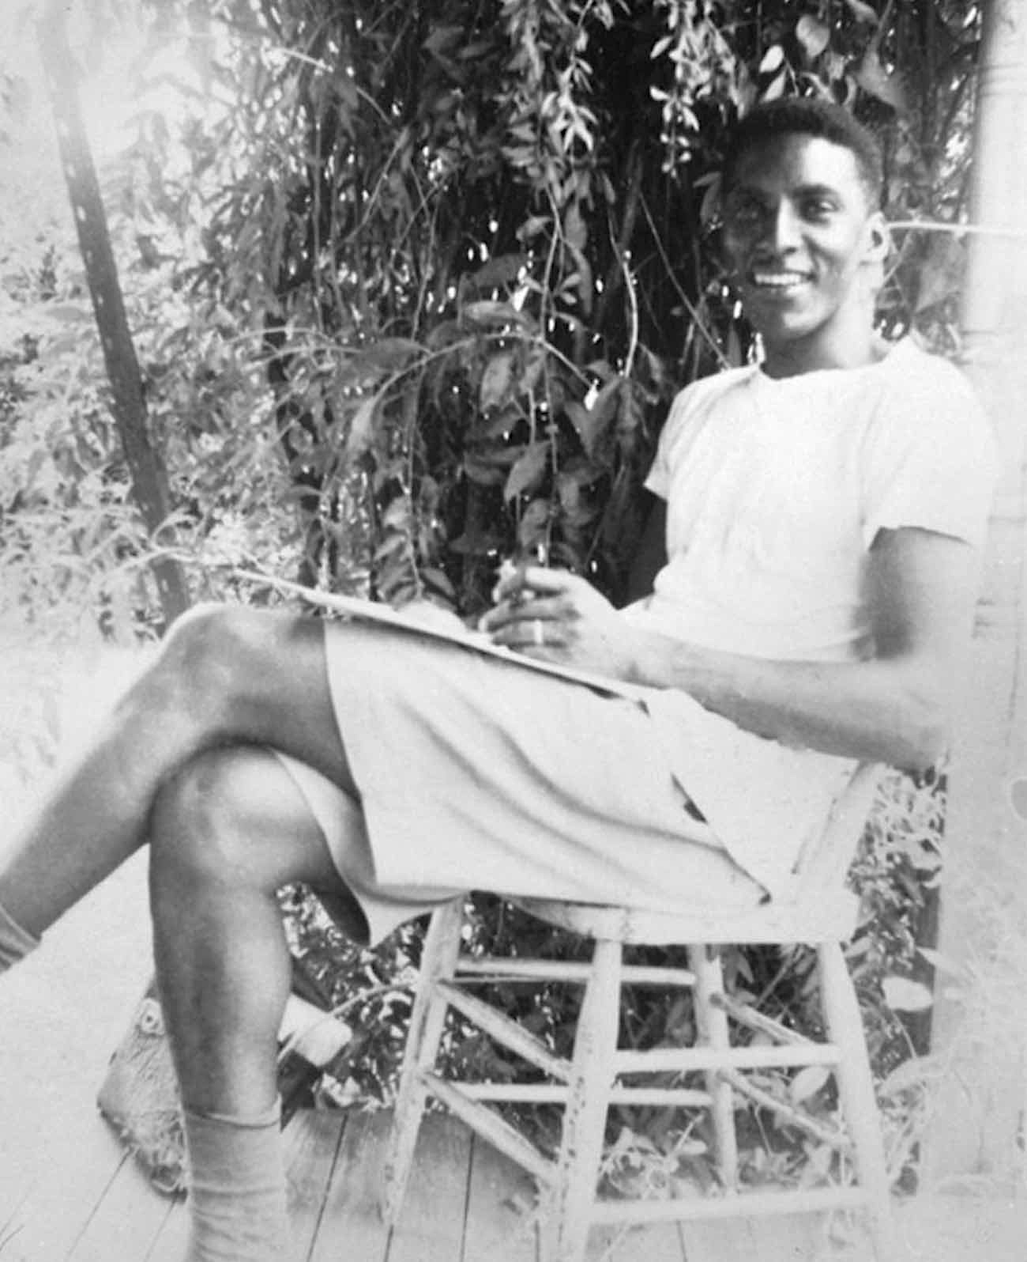
Introduction to Activism
After graduating from West Chester High School, Rustin studied intermittently at Wilberforce University, Cheyney State Teachers College, and City College of New York.
While a student at City College in the 1930s, Rustin joined the Young Communist League (YCL). Drawn to what he believed was the Communists’ commitment to racial justice, Rustin left the organization in 1941, when the Communist Party shifted its emphasis away from civil rights activities. Rustin later said about this episode:
“It was inescapably clear that I had been wrong.”
Shortly after departing YCL, Rustin was appointed youth organizer of the proposed 1941 March on Washington, by trade union leader A. Philip Randolph. That protest did not take place, but it contributed to Rustin’s growing reputation as an activist and organizer.

Slide 7
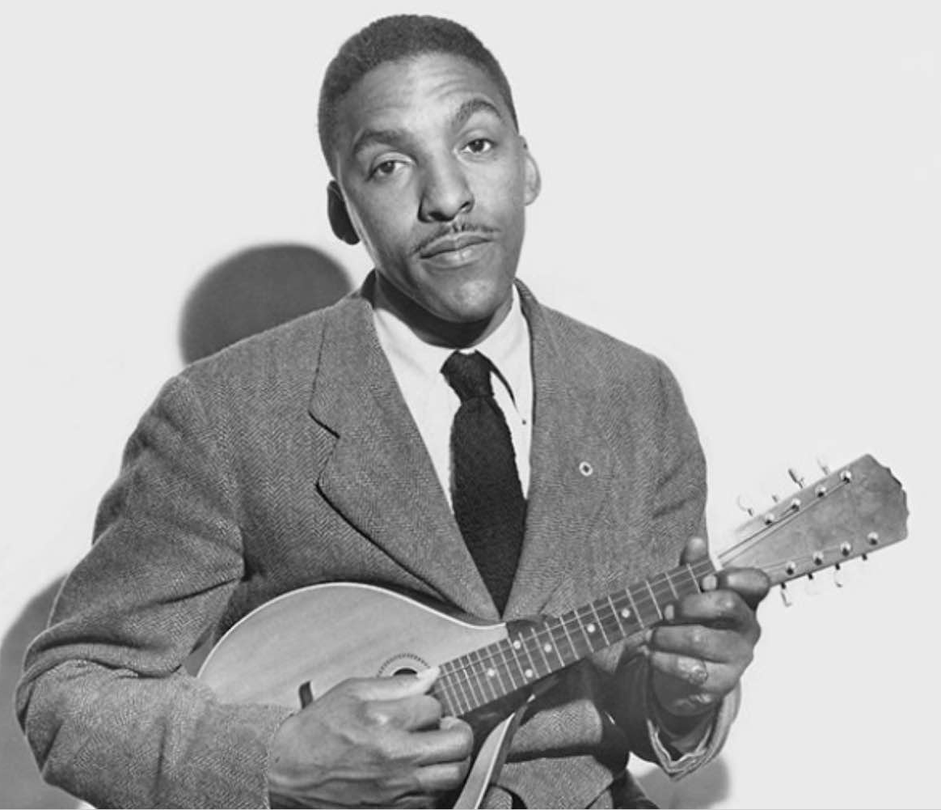
World War II
World War II began in Europe in 1939; the United States remained officially neutral until December 8, 1941.
In 1940, Rustin received a draft notice and, as a Quaker, he was classified as a “conscientious objector.” Three years later he was assigned to work in a civilian public service camp. “My conscience motivates me to combat by nonviolent means the ever-growing racial tension in the United States,” he wrote to the draft board, explaining his refusal to report.
“At the same time the government directs that I follow the conscription law. Which path shall I take – that directed by my faith or that of my country? … when there is a conflict, I must follow the Lord’s will.”
Rustin posing with the lute he taught himself to play, while incarcerated as a conscientious objector, 1947
Rustin’s principled refusal to serve in the armed forces, even as a non-combatant, led to two years of imprisonment. After release, he worked for the Fellowship of Reconciliation, a pacifist organization that pioneered nonviolent direct action in the North, and he helped establish the Congress on Racial Equality (CORE), a more confrontational civil rights organization.

Slide 8
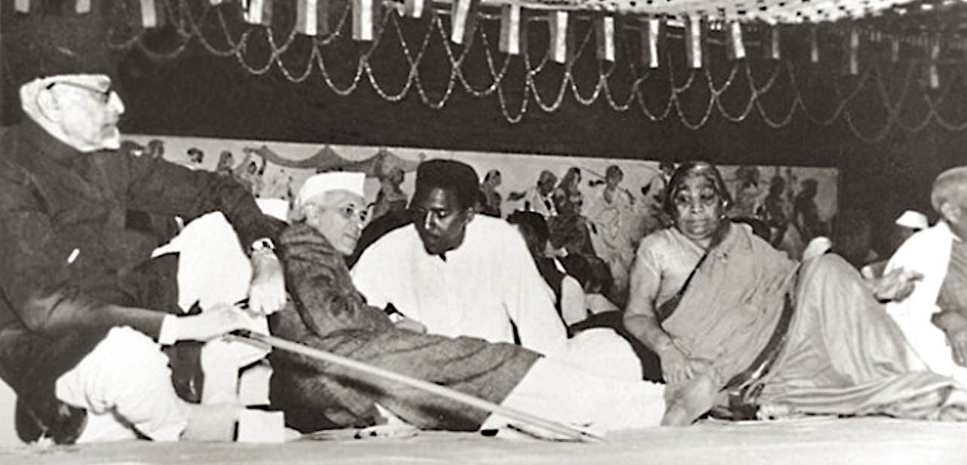
Rustin’s Trip to India, 1948-49
In 1948, Mohandas Gandhi was assassinated by a Hindu extremist. A few months later, India became independent from the British Empire.
Rustin traveled to India to learn directly about the principles of Gandhian non-violent resistance.
While in Asia, Rustin met Prime Minister Jawaharlal Nehru, a disciple of Gandhi, who had become independent India’s first Prime Minister.

Slide 9
Origins of the Civil Rights Movement
The Civil War ended in 1865. Soon afterwards, the Thirteenth Amendment to the U. S. Constitution, which abolished slavery, was ratified.
What became known as the Civil Rights Movement had its origins in Reconstruction, during which the Fourteenth (1868) and Fifteenth (1870) Amendments also were ratified. For decades, however, these laws were not enforced.
In 1954, the Supreme Court decided Brown v. Board of Education and held that racial segregation in public schools violated the Fourteenth Amendment equal protection clause.
The next year, Black passengers began boycotting the segregated bus system in Montgomery, Alabama, transforming the Civil Rights Movement from a legal abstraction to protest against dis crimination in everyday life.

Slide 10
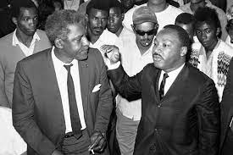
Dr. Martin Luther King Jr.
In 1956, A. Philip Randolph, the veteran labor and civil rights leader, connected Rustin with Martin Luther King Jr., a young Baptist minister chosen by Black leaders in Montgomery to coordinate the city-wide bus boycott.
Dr. King, an inspiring orator, and Bayard Rustin, an energetic organizer, made a superb team.
Bayard Rustin, listening to Dr. King

Slide 11
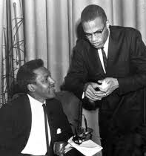
Fissures in the Struggle for Black Freedom
In the 1960s, the struggle for Black freedom was complicated by large personalities and deep policy disagreements.
Two largely opposed perspectives were laid out in a debate titled “Separation and Integration” between Malcolm X and Bayard Rustin in New York City in September 1962.
(Pictured at left.)
Malcolm’s position was evolving and moderating when he was assassinated in February 1965.

Slide 12
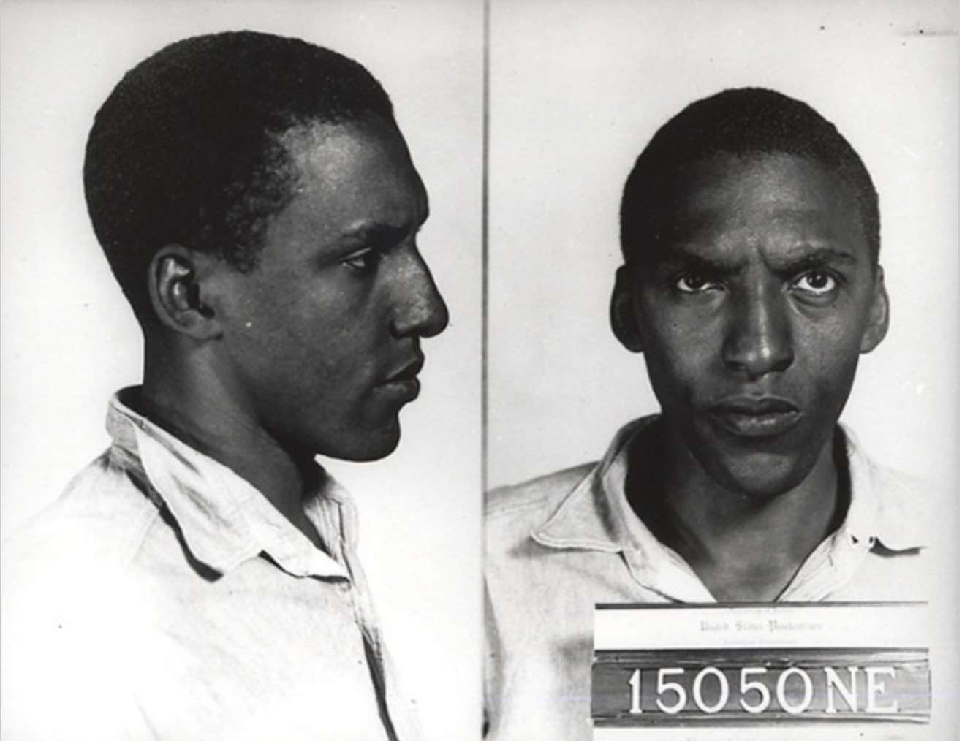
Rustin’s “Open Secret”
On January 22, 1953, after giving a speech, Rustin had been arrested in Pasadena, California, for having sex with two White men in an automobile. Rustin was eventually convicted of a misdemeanor violation of Penal Code section 647.5 - Vagrancy, sentenced to 60 days in jail, and ordered to register as a sex offender. Rustin concluded,
“I [knew] now that for me sex must be sublimated if I [were] to live with myself and in this world longer.”
Ruskin’s “open secret” about his sexuality was known to close friends in the activist community and to law enforcement.
Bayard Rustin, Arrest photos, Pasadena 1953
For years following this incident, according to historian Henry Louis Gates Jr., Rustin was deeply involved in various causes, but “remained out of sight.”
In 2020, nearly 70 years later, California Governor Gavin Newsom gave Rustin a posthumous full pardon, writing that his arrest, conviction, time served, and sex offender registration, were all the result of unfair discriminatory laws, which led to years of Rustin being denigrated, mocked and excluded.

Slide 13
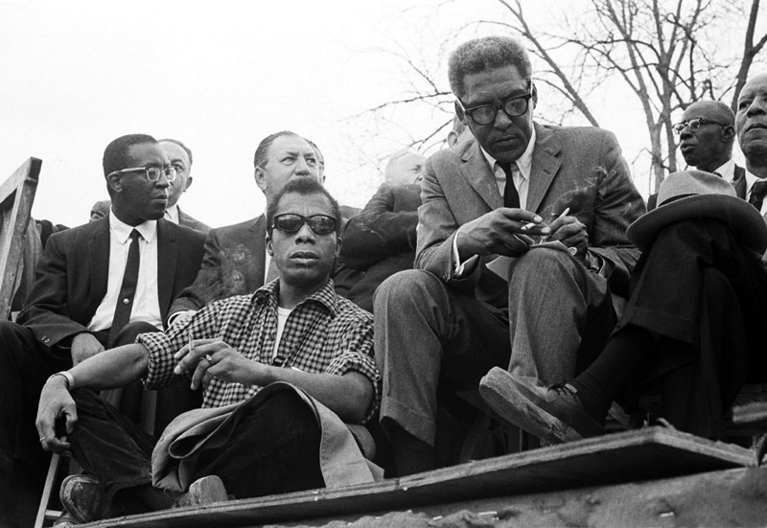
F.B.I. Surveillance
This is a photograph of writer and activist James Baldwin, sitting next to Bayard Rustin. Both men were gay.
Director J. Edgar Hoover’s Federal Bureau of Investigation surveilled Baldwin and Rustin, likely seeking information that could later be used to blackmail them.

Slide 14
Attempts to Discredit Rustin in Congress
Few critics of the Civil Rights Movement were more outspoken than Senator Strom Thurmond, then a Democrat from South Carolina. In early August 1963, in an attack on the March on Washington, Thurmond bitterly denounced Bayard Rustin as a Communist, draft dodger, and homosexual.
With great dignity, Rustin refused to engage his critics, declaring:
“With regard to Senator Strom Thurmond's attack on my morality, I have no comment. By religious training and fundamental philosophy, I am disinclined to put myself in the position of having to defend my own moral character. Questions in this area should properly be directed to those who have entrusted me with my present responsibilities.”

Slide 15
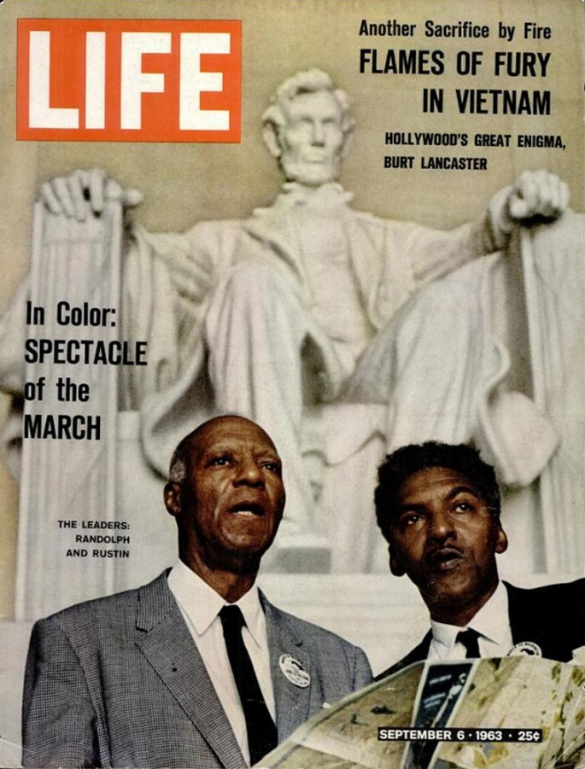
The March on Washington, 1963
The highlight of Rustin’s long career in activism was his service as the principal organizer of the historic March on Washington for Jobs and Freedom. The event was the setting for Dr. Martin Luther King Jr.’s historic speech:
“I Have a Dream.”
A few days later, Life magazine, an important influencer of popular culture and public opinion, published an issue with a cover image of Bayard Rustin and his longtime mentor, A. Philip Randolph. In the image, they stood in front of Daniel Chester French’s majestic sculpture of President Abraham Lincoln at the Lincoln Memorial, National Mall, in Washington, DC.

Slide 16
“From Protest to Politics”
After the March on Washington, Rustin urged the Civil Rights Movement to shift its focus to politics, and he energetically supported the federal legislation leading to Congress’s passage of the Civil Rights Act of 1964 and the Voting Rights Act of 1965.
In that year, with a founding grant from the AFL-CIO, a coalition of labor unions, Rustin created the A. Philip Randolph Institute (APRI), to build an interracial coalition that would promote racial justice and secure jobs and freedom for all Americans. Rustin served as APRI's executive director from 1965 until 1972, and then until his 1987 death, as its honorary president.
Under Rustin's leadership, APRI announced a "Freedom Budget" that proposed to eliminate poverty in 10 years, conducted a nationwide voter registration campaign and ran a successful program to prepare people of color for apprenticeships in the building trades.

Slide 17
The Vietnam War
In the 1960s, the disastrous Vietnam War was a deeply polarizing event that frequently set longtime allies against each other.
While attempting to mobilize support for the Civil Rights Movement in the political mainstream, Rustin was perceived to be too close to leading Democrats, including Vice President Hubert Humphrey, and this troubled proponents of Black Power.
Rustin alienated antiwar activists by refusing to call for the immediate withdrawal of American troops from Vietnam and, in 1967, he advised Dr. King against speaking out to criticize the war in the powerful speech King delivered at Riverside Church in New York City.

Slide 18
Other Perspectives
Rustin had other differences with student activists in the late 1960s. At a time when many colleges and universities were considering adding Black Studies courses and programs to their curricula, Rustin criticized the movement, asserting that these areas of study would not prepare students for the challenges of the workplace.
At about the same time, Rustin clashed with one-time allies. On April 6, 1968, two days after Dr. King was assassinated in Memphis, Tennessee, Rustin received the United Federation of Teachers' (UFT) Dewey Award, an acknowledgment by the New York City union of the civil rights leader’s long, far-reaching contributions to progressive social activism.
In what one observer described as a “pessimistic” acceptance speech, Rustin lamented conflict between the city’s teachers’ union, mostly White, and civil rights leaders, mostly Black, who demanded “community control” of the public schools.

Slide 19
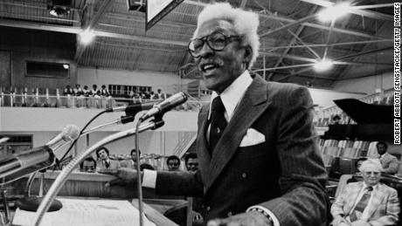
Rustin and the Gay Rights Movement
Rustin is described in some sources as a “closeted” gay man. In fact, he always was honest about his sexual orientation, but he did not become a gay rights activist until late in life. Rustin was increasingly outspoken in the 1980s, and, in 2003, 16 years after his death, writer and social critic Nat Hentoff titled an article in The Village Voice about Rustin, “An Indispensable Gay Man.”

Slide 20
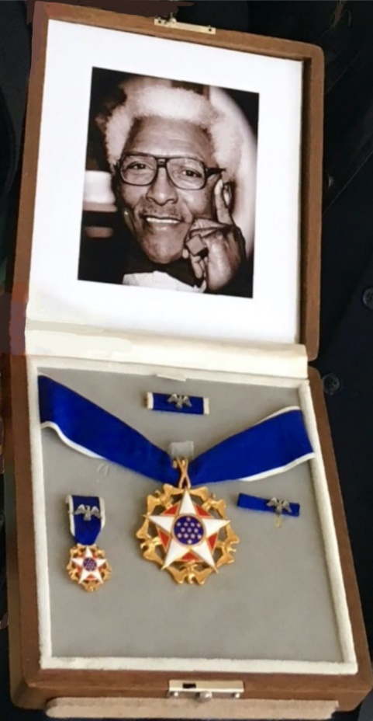
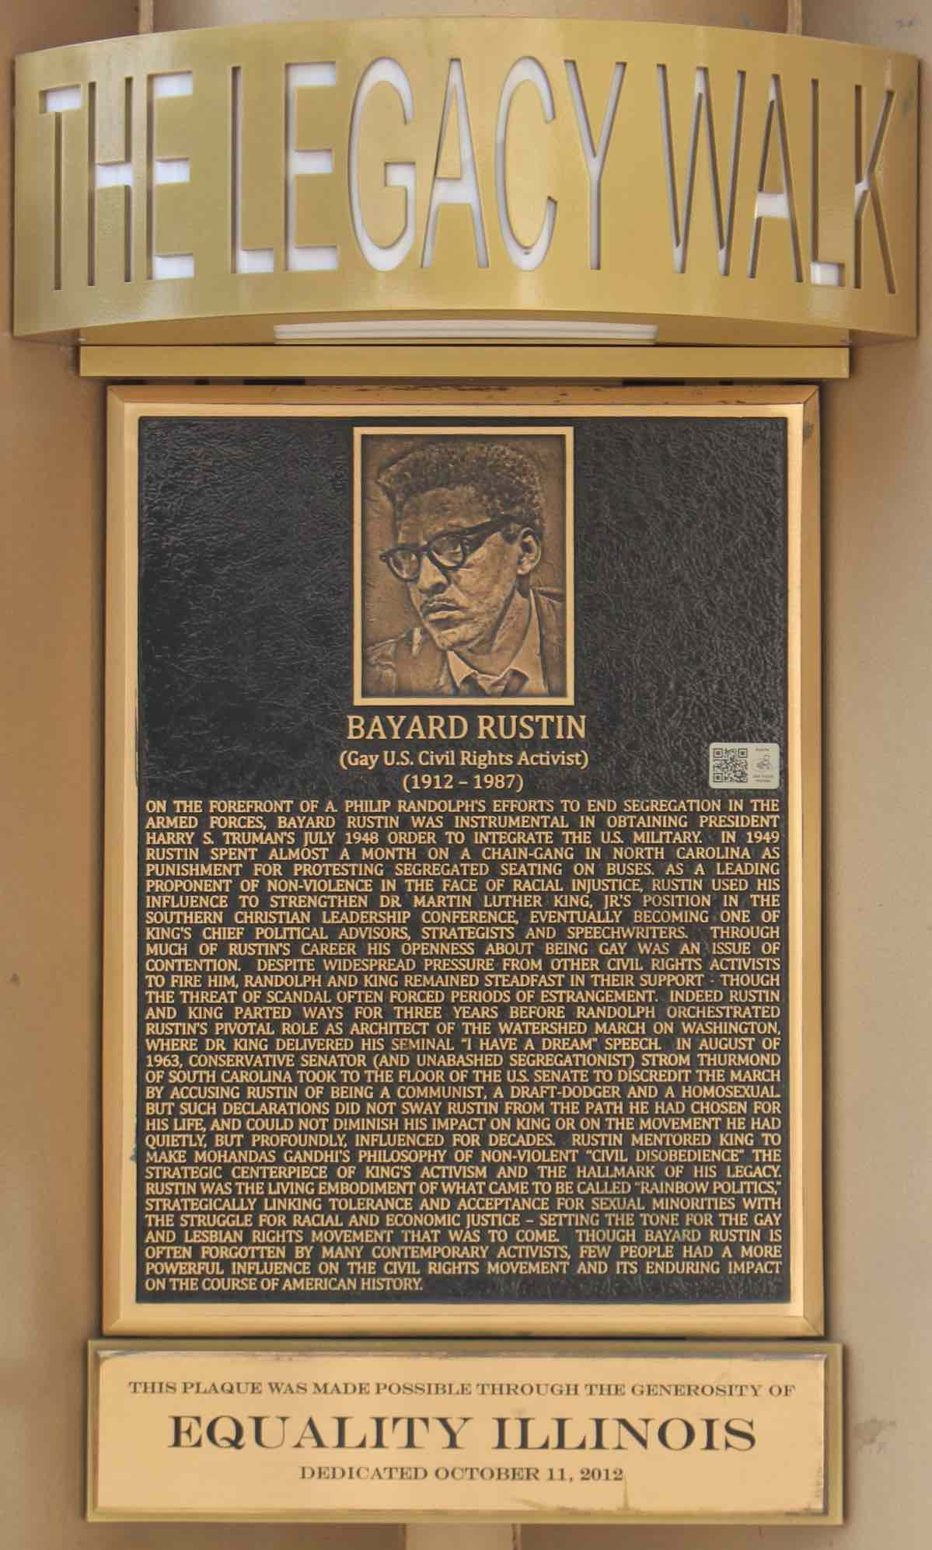
Enduring Fame
In August 2013, President Barack Obama posthumously awarded Bayard Rustin the Presidential Medal of Freedom.
In November 2013, Walter Naegle, Rustin’s partner, accepted the medal on his behalf, from Pres. Obama, in an East Room White House ceremony.
The Presidential Medal of Freedom is the highest honor a president can award a civilian; Obama honored Rustin’s five decades of activism and service to the Civil Rights Movement.
Bayard Rustin Memorial
Heartland Alliance
Chicago, Illinois
Presidential Medal of Freedom
Bayard Rustin 2013

Slide 21
Concluding Thoughts
A tribute by the AFL-CIO, the coalition of labor unions, described Bayard Rustin as an activist who “served the trade union and civil rights movements as a brilliant theorist, tactician and organizer.”
According to historian John D’Emilio, who wrote an authoritative biography of Rustin, his subject,
“more than anyone else in the postwar era, was a bridge linking the African American freedom struggle, peace campaigns, and a socialist vision of economic democracy.”
Over 25 years after Professor D’Emilio wrote that, it remains accurate and quite an achievement!
Perhaps more than any other quality, Rustin had the courage of his convictions. He took stands that often were unpopular and defended them with vigor.

Slide 22
Selective Bibliography
Branch, Taylor, Parting the Waters: America in the King Years, 1954-1963 (Simon & Schuster Paperbacks, 1988)
D’Emilio, John, Lost Prophet: The Life and Times of Bayard Rustin (University of Chicago Press, paperback, 2004)
Garrow, David J., Bearing the Cross: Martin Luther King, Jr., and the Southern Christian Leadership Conference (William Morrow, First Quill Edition, 1999)
Isserman, Maurice & Michael Kazin, America Divided: The Civil War of the 1960s (Oxford University Press, 2000)
Joseph, Peniel E., The Sword and the Shield: The Revolutionary Lives of Malcolm X and Martin Luther King Jr. (Basic Books, paperback, 2021)
Leighton, Jared, “’Character Assassins’: How the FBI Used the Issue of Homosexuality against the Black Freedom Struggle”, Journal of Civil and Human Rights , Vol. 2, No. 2 (Fall/Winter 2016), pp. 151-185
Sitkoff, Harvard, King: Pilgrimage to the Mountaintop (Hill and Wang, paperback, 2009)

