Slide 1
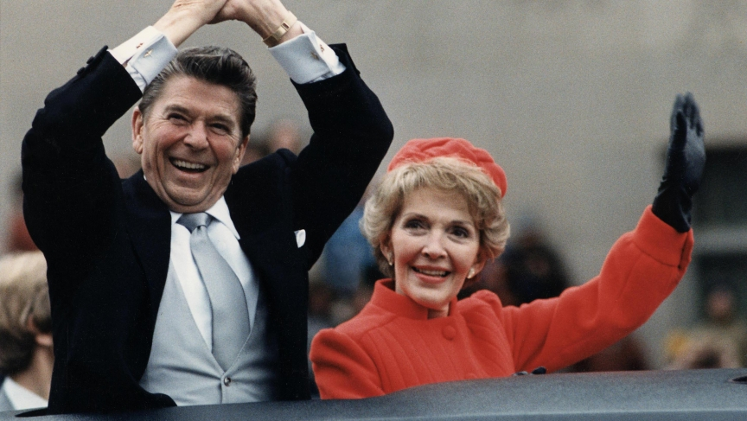
WALT WHITMAN WEPT:
PRESIDENT RONALD REAGAN and the AIDS EPIDEMIC
Presented by
Steven S. Berizzi
Professor, History & Political Science, Norwalk Community College

Slide 2
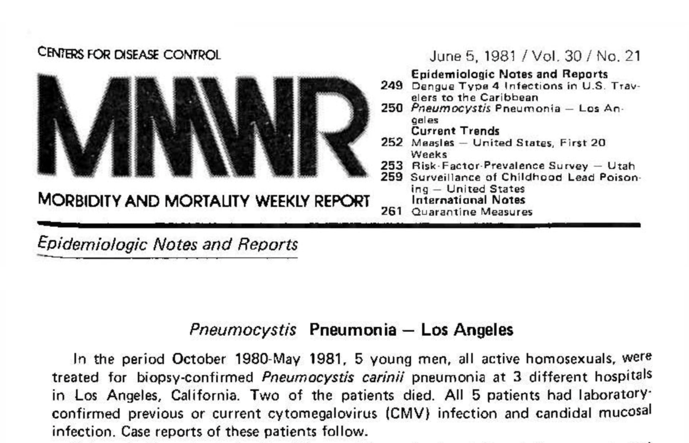
The Centers for Disease Control
The federal Centers for Disease Control [CDC] publishes the Morbidity and Mortality Weekly Report, with epidemiological notes and similar information from across the nation. On June 5, 1981, fewer than six months after President Reagan took office, MMWR published the first written report of a cluster of cases of a rare form of pneumonia among previously healthy young men in Los Angeles. This would eventually be called Acquired Immune Deficiency Syndrome, shortened to AIDS.
On July 3, 1981, The New York Times published its first article about AIDS, headlined “Rare Cancer Seen in 41 Homosexuals.”

Slide 3
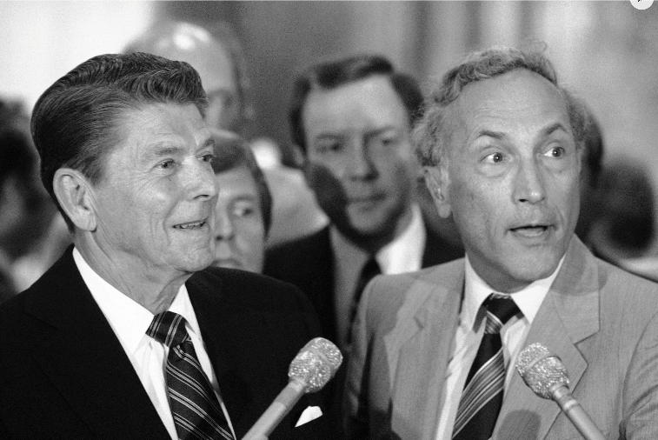
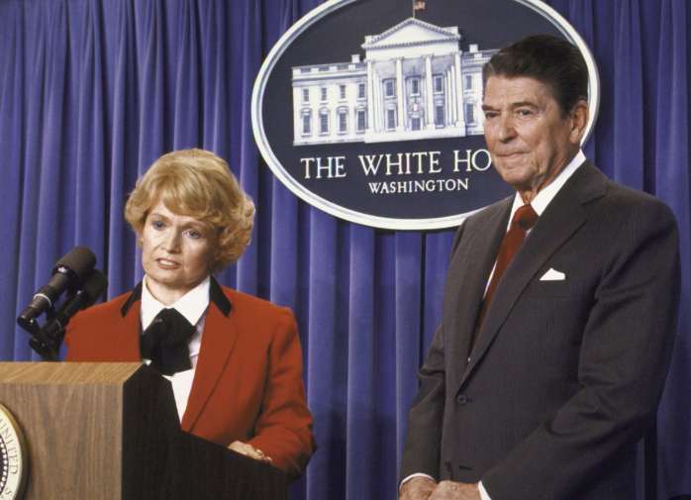
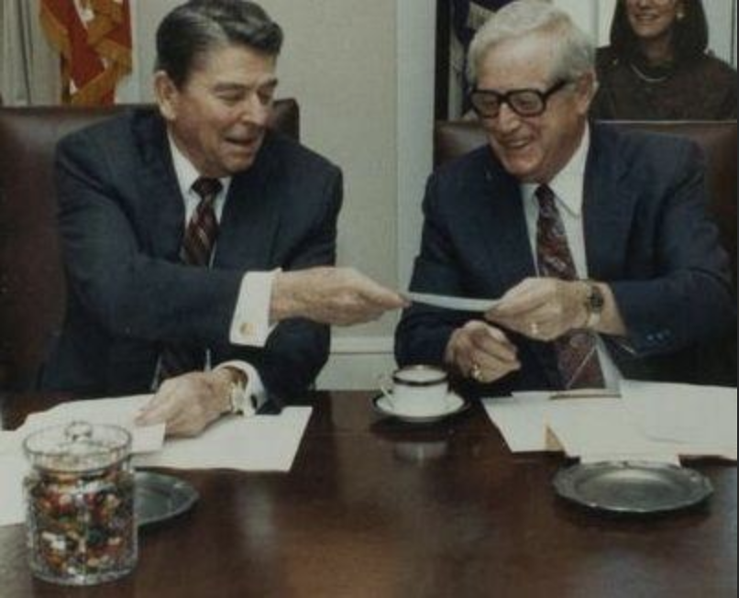
American Government’s Intentions and Reality: Responding to the AIDS Epidemic in the 1980s
President Reagan’s secretaries of Health and Human Services were, pictured with Reagan from left to right, Richard Schweiker (1981-1983), Margaret Heckler (1983-1985), and Otis Bowen, M.D. (1985-1989). All three were politicians, but Bowen also was a physician.
During their tenures at the Department of Health and Human Services, Schweiker and Heckler claimed federal support for AIDS research was adequate. Dr. Bowen knew better and sought more funding, although critics said his department did not do enough.
According to Dr. Donald Francis, who became one of the leading AIDS experts at the federal Centers for Disease Control: The CDC “was very capable of responding, as it has done with innumerable disease outbreaks before and since. But with AIDS, the Reagan
administration prevented it from responding appropriately to what very early on was known to be an extremely dangerous transmissible
disease. Without clearly understanding the deadly forces that inhibited CDC at that time, we may well face them again when trying to deal with future outbreaks.”

Slide 4
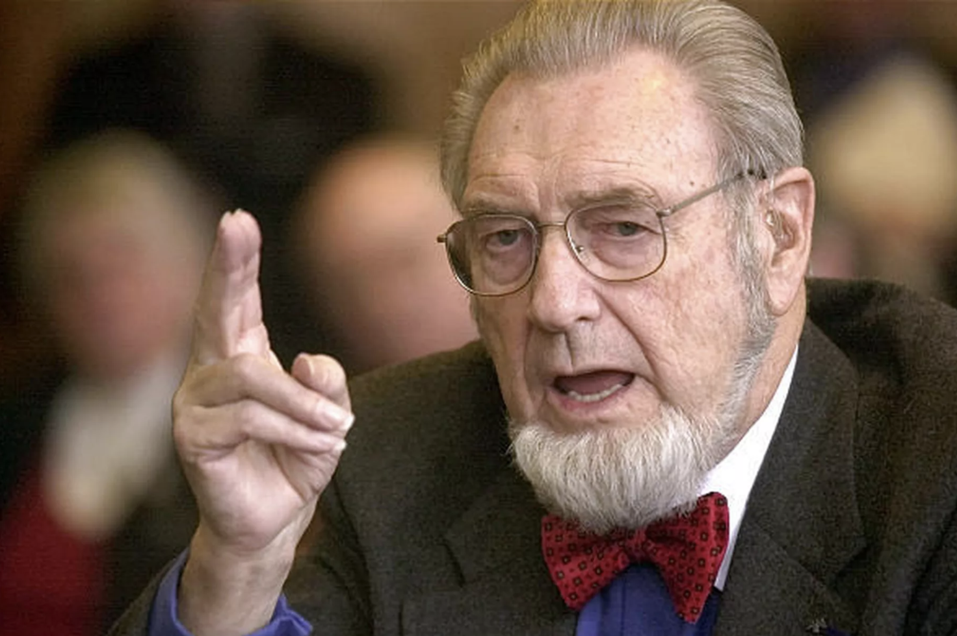
Surgeon General C. Everett Koop, M.D.
From 1982 until 1989, most of the Reagan presidency, C. Everett Koop, M.D., a Pennsylvania pediatric surgeon, served as Surgeon General, the chief public health officer of the United States.
Dr. Keep was a well-known conservative, with strong ties to the Christian Right, but he came to believe the AIDS epidemic was a strictly medical issue, not a moral one, and he forcefully addressed AIDS. Koop was a proponent of frank sex education, a position that infuriated his right-wing critics.
Dr. Koop’s Surgeon General's Report on Acquired Immune Deficiency Syndrome, which was issued in 1987, has been described by one public health policy expert as “transformative.”

Slide 5
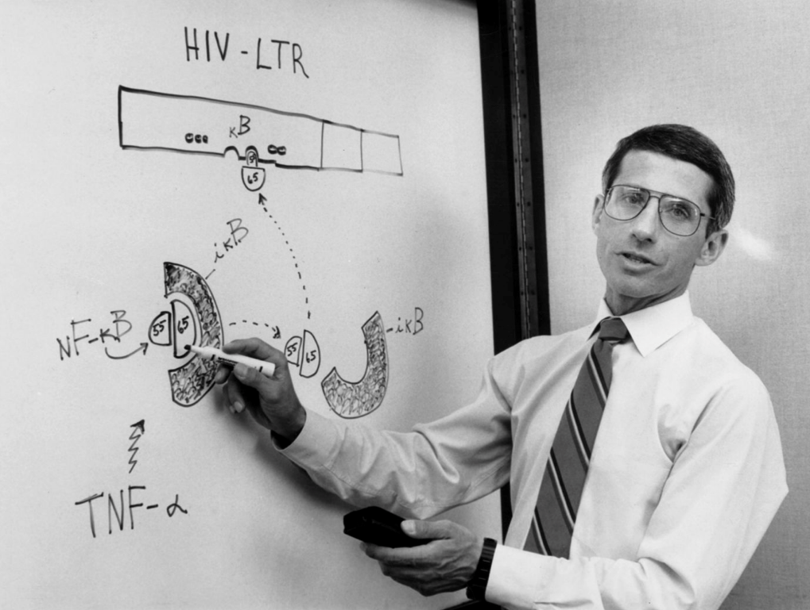
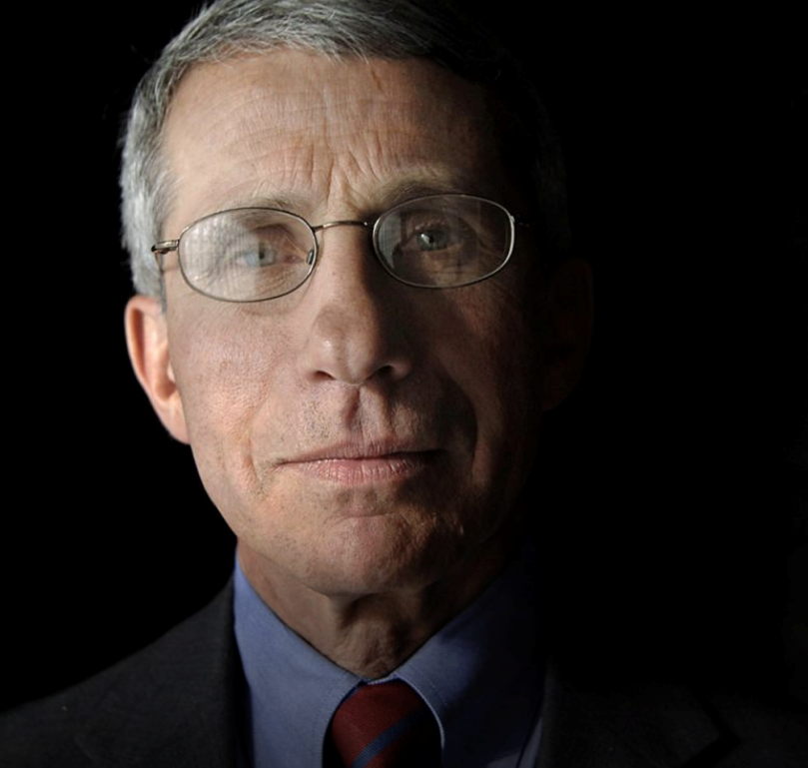
Anthony Fauci, M.D.
Dr. Anthony Fauci, as the chief of AIDS research at the National Institutes of Health, talks with colleagues in his laboratory in 1990.
Photo credits, George Tames, The New York Times/Redux
Dr. Fauci has been the United States' top infectious disease expert since 1984.
Photo credit: Jack Atley/Bloomberg/Getty
During the early years of the AIDS epidemic in the 1980s, Anthony Fauci, M.D., as a physician at the federal National Institutes of Health, served as Chief of the Laboratory of Immunoregulation and coordinator of his agency’s AIDS research program. In 1984, Dr. Fauci was named Director of the National Institute of Allergy and Infectious Diseases.
Nearly 40 years later, beginning in early 2020, Dr. Fauci became widely recognized as a leading scientific expert about the coronavirus pandemic.

Slide 6
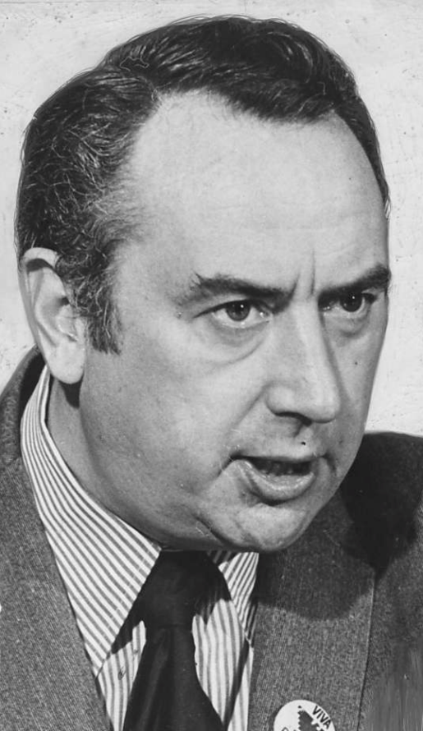
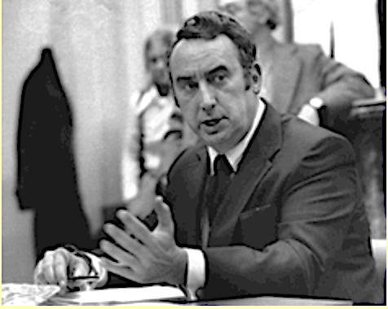
Representative Philip Burton, Democrat of California
Representative Phil Burton served in the House of Representatives from 1964 until he died from a heart attack in 1983. His district covered about two thirds of San Francisco.
In the late 1970s and early 1980s, Burton was one of the most powerful people in the House and an outspoken champion of many liberal causes. He was one of the first members of Congress to have an openly-gay man on his staff, and Burton was an early supporter of federal funding for AIDS research and treatment.

Slide 7
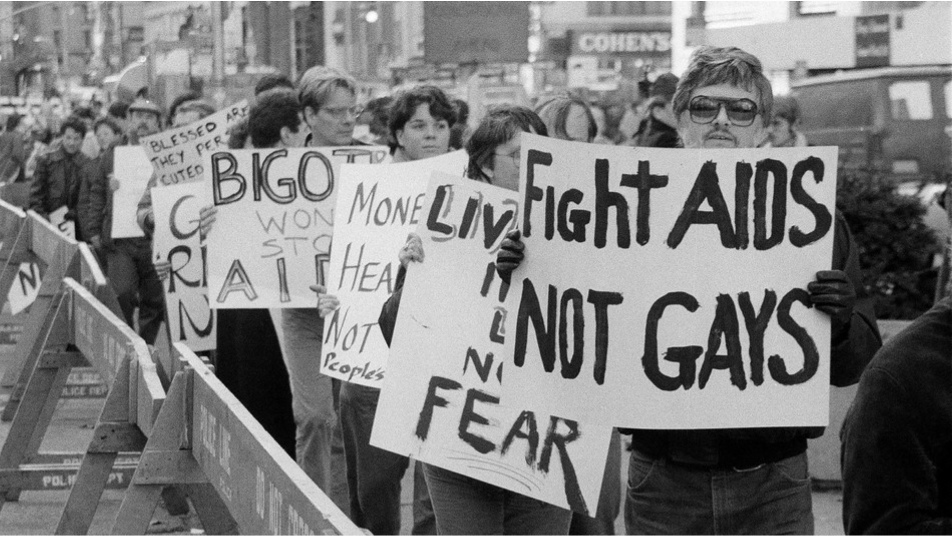
New York City AIDS Activism
Demonstrators protest near NYC’s City Hall, as inside a City Council committee considered legislation to bar pupils & teachers with the AIDS virus, from public schools. November 15, 1985.
Photo credit: Rick Maiman/AP

Slide 8
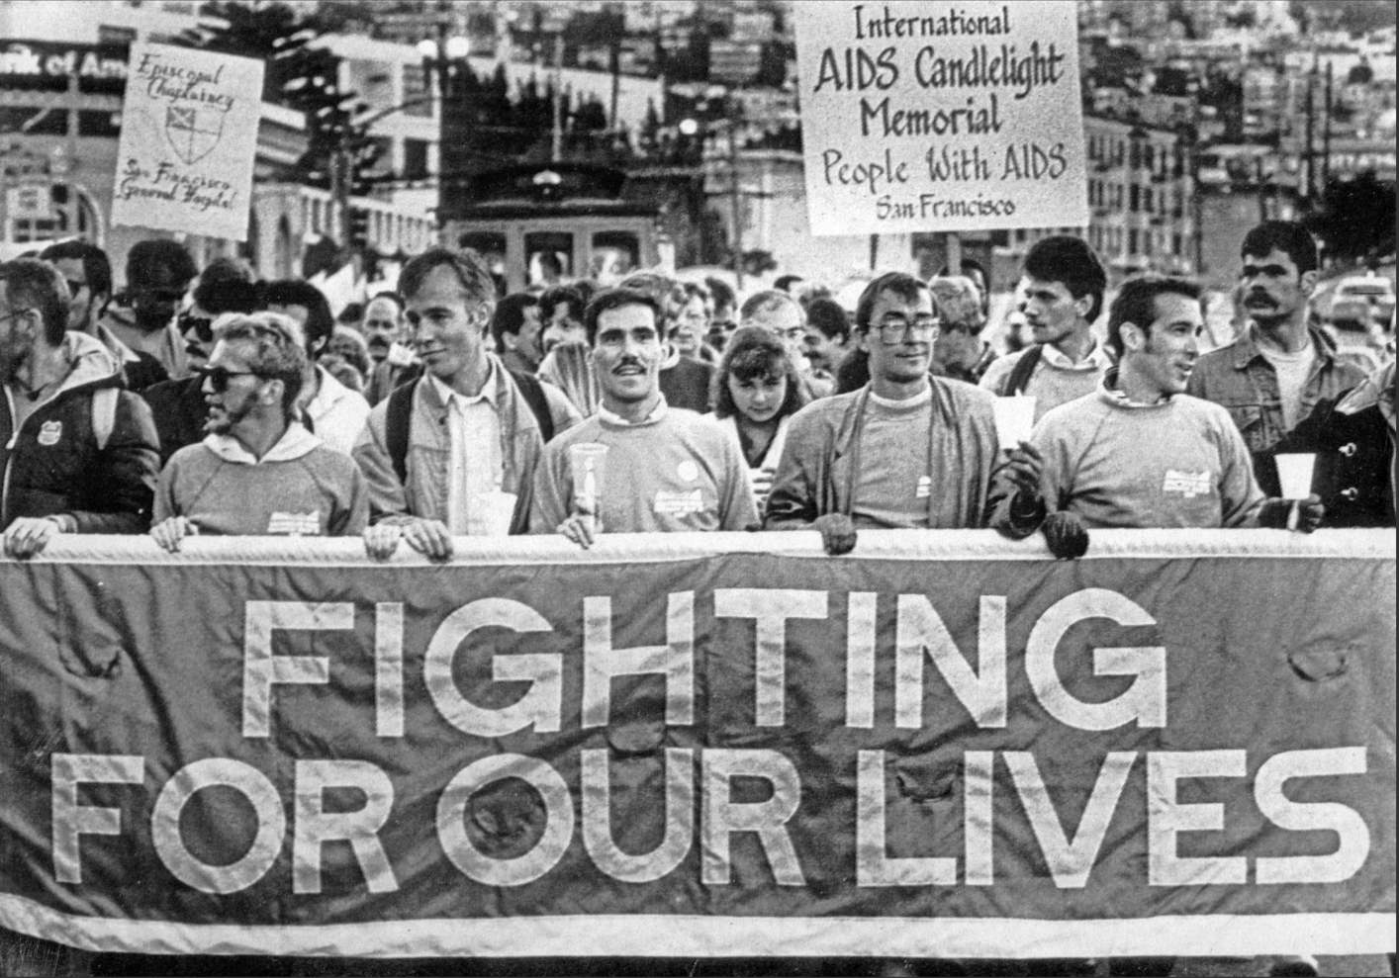
San Francisco AIDS Activism
An estimated 5,000 marched in the annual AIDS candlelight march on May 26, 1986.
Photo cred: John Green/UP!

Slide 9
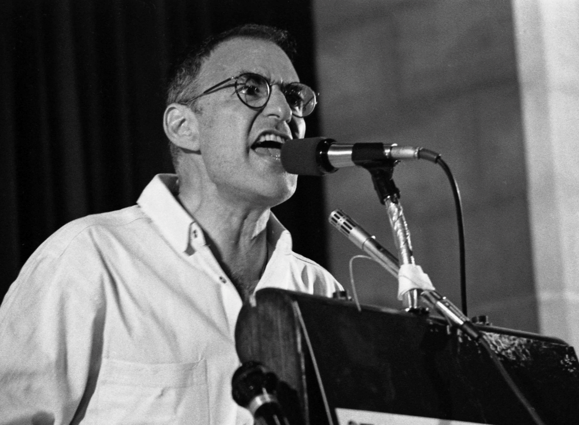
Prophet Larry Kramer, AIDS Activism, Homophobia, and the Federal Response to the AIDS Epidemic
Larry Kramer was a New York City playwright and author, a highly outspoken gay rights activist, and one of the founders of the Gay Men’s Health Crisis organization.
In the early 1980s, Kramer was among the first outside the medical profession
to foresee that what had at first been viewed as a rare form of cancer among gay men could spread worldwide and kill millions.
In the winter of 1984, Kramer went to Washington to meet with federal health officials, seeking increased funding for AIDS research, treatment, and prevention. One CDC physician asked Kramer: “Why don’t you guys get married…to women?”
In 2020, the United Nations reported that
32.7 million people had died from AIDS-related illnesses since the start of the epidemic.
Kramer died in May 2020 at age 84.
Author and activist Larry Kramer at an AIDS conference in New York in 1987
Photo credit: Catherine McGann/Getty Photo credits

Slide 10
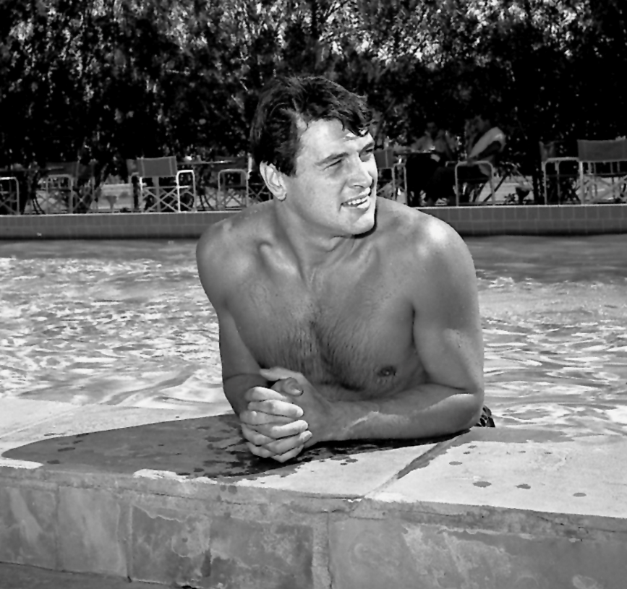
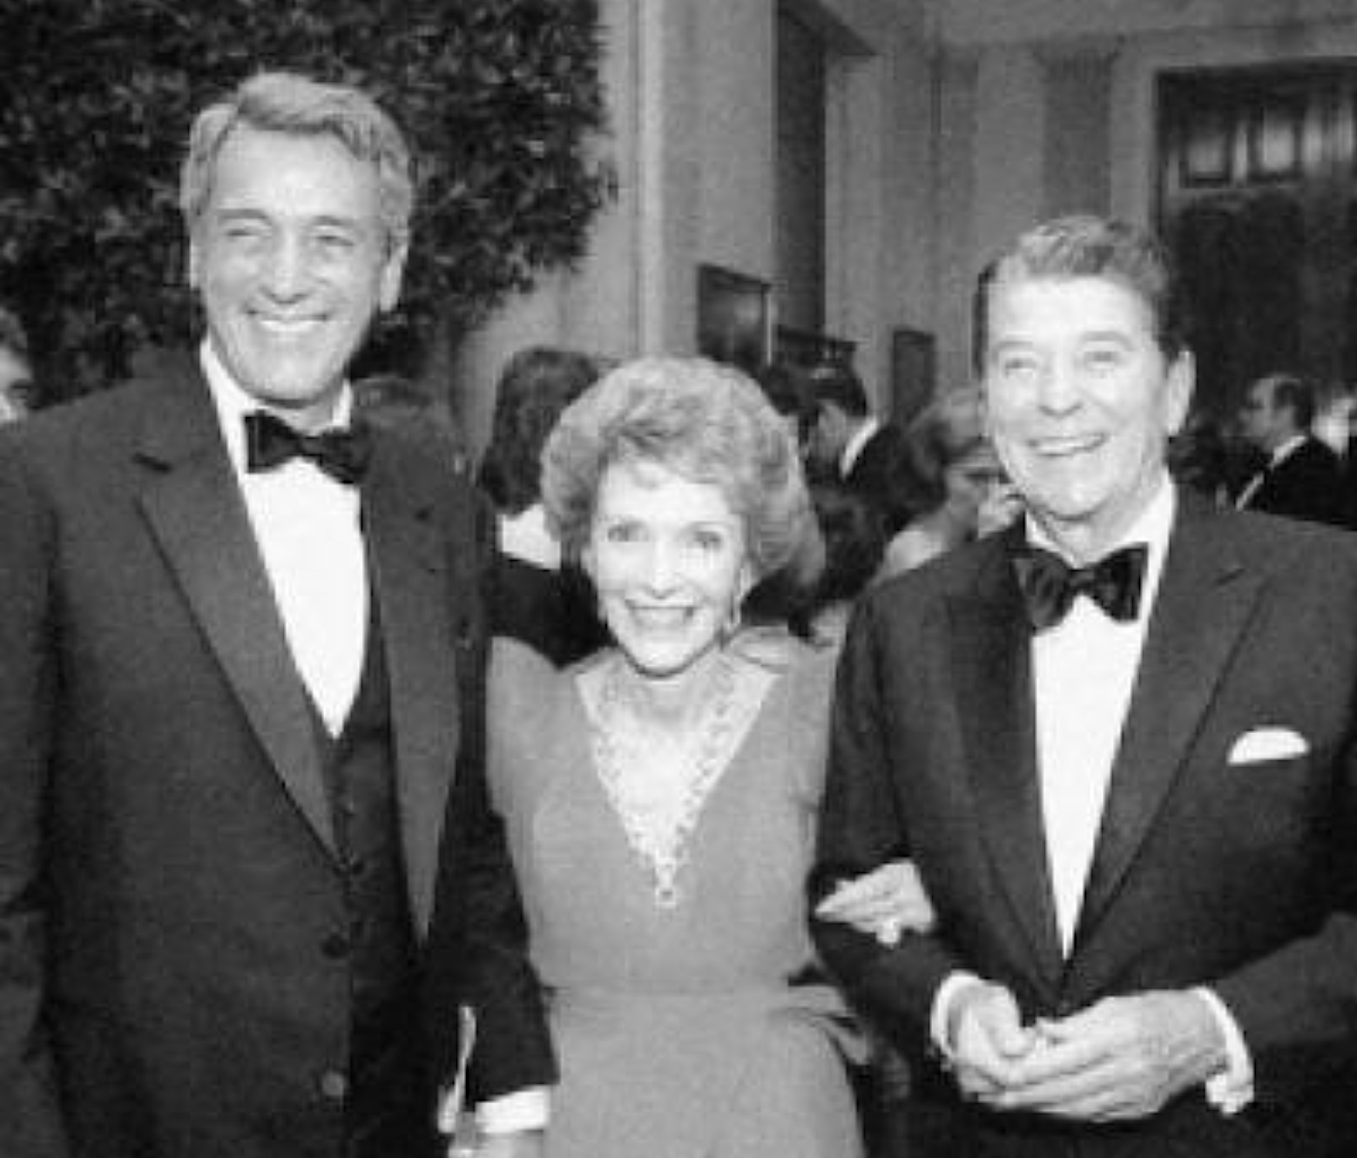
Faces of AIDS: Rock Hudson
Rock Hudson in 1954,
at about the time he became a leading man in films
Photo credit: Bill Anderson
In 1984, the year before he died, Rock Hudson was photographed at a White House event with old friends First Lady Nancy Reagan and President Reagan
Legendary film star Rock Hudson died from AIDS in 1985

Slide 11
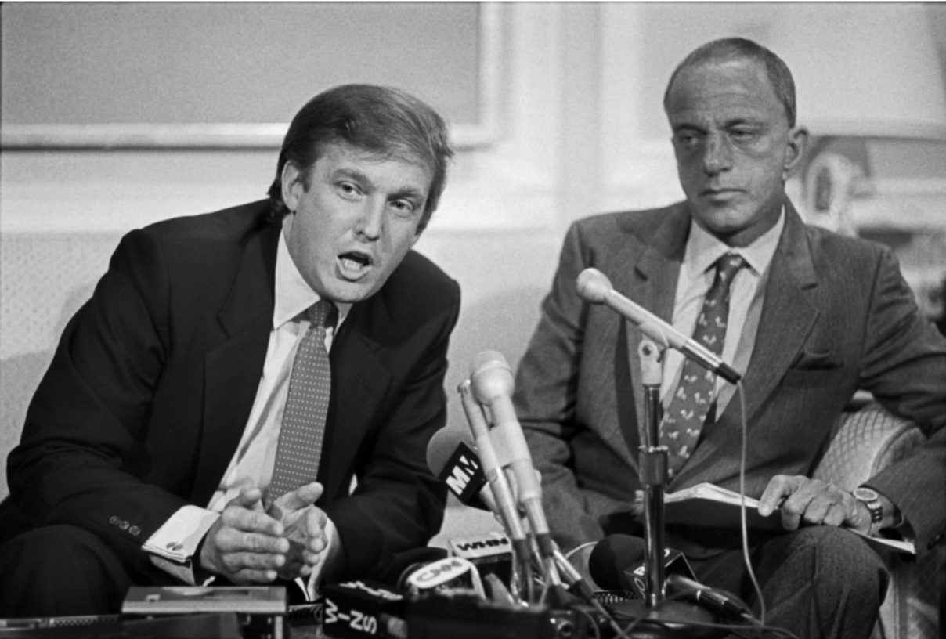
Faces of AIDS: Roy Cohn
Roy Cohn came to national attention in the early 1950s as counsel to Senator Joseph McCarthy’s notorious investigating committee. After leaving government, he was a prominent, but controversial, lawyer in New York City. One of his clients was young Donald Trump.
Cohn was a longtime resident of Greenwich, Connecticut. Although Cohn occasionally was photographed with women at social events, he was widely believed to be homosexual. In 1986, Cohn died. The reported cause of death was liver cancer, but he probably had AIDS
A news conference by Donald Trump and attorney Roy Cohn, at the offices of Saxe, Bacon & Bolan in New York City, announcing a billion dollar lawsuit against the National Football League,
October 18, 1984
Phot credit: Marilynn K. Yee, The New York Times/Redux

Slide 12
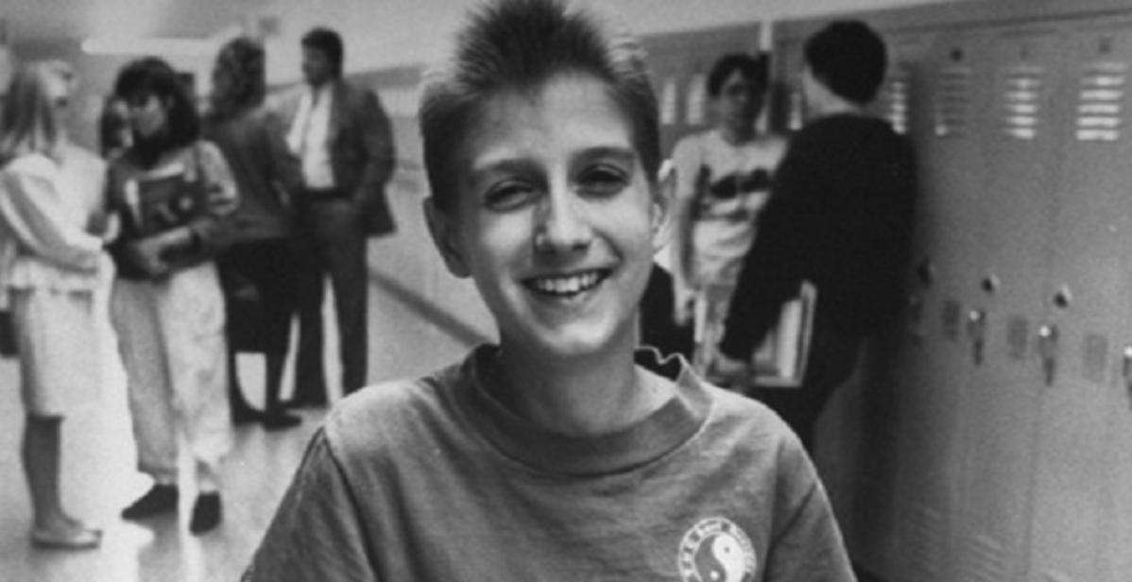
Faces of AIDS: Ryan White
Ryan in the hallway of Hamilton Heights High School, 1987
Courtesy of Time & Life Magazine.
Ryan White, an Indiana teenager, was a hemophiliac who contracted AIDS from a blood transfusion. Forced to leave the public high school he was attending, Ryan’s case was widely reported in the national media. After transferring to another high school, he graduated, and died in 1990 at age 19.

Slide 13
Faces of HIV: Greg Louganis
Greg Louganis was the greatest diver in the world in the 1980s, winning both the springboard and platform Olympic gold medals at Los Angeles in 1984 and Seoul, South Korea, in 1988. He was the first man in 56 years to win both events.
Later that year, Louganis tested positive for HIV, but he did not reveal that fact or otherwise come out for many years, fearing he would lose lucrative endorsement income. As a reporter wrote in 1994, Louganis “could beat everything but homophobia”.
Greg Louganis, at about the time of the
Seoul Summer Olympics, 1988.
Photo credit: Dave Black

Slide 14
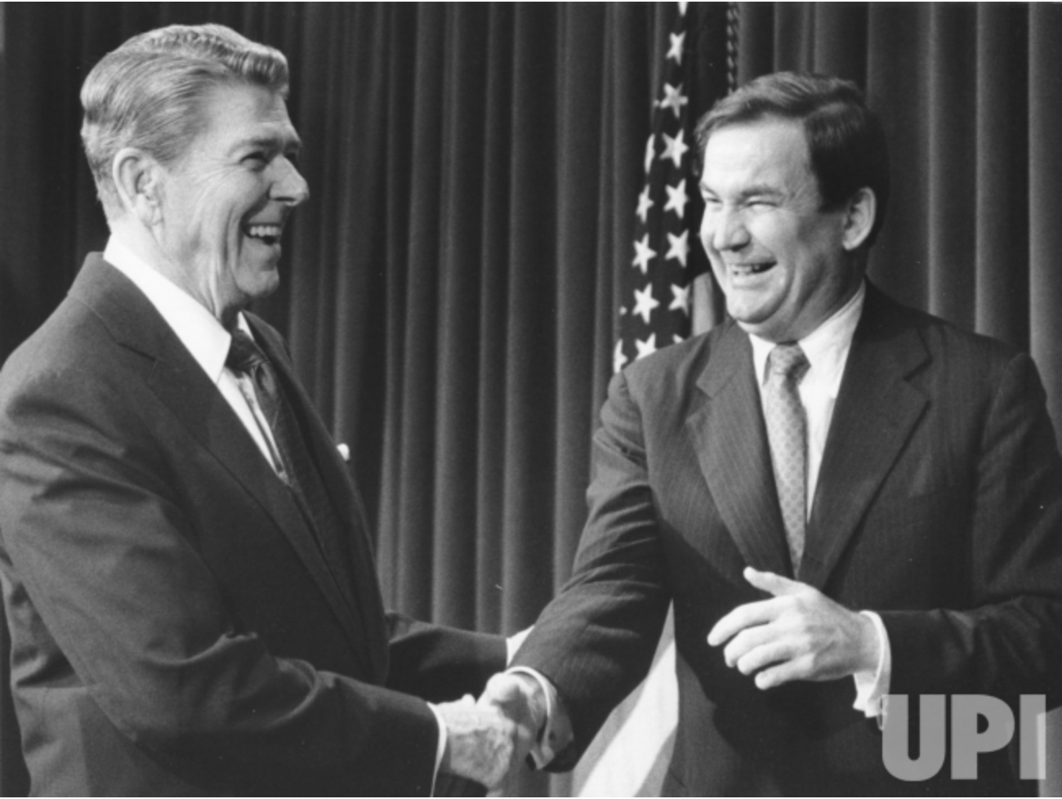
Voices of Homophobia: Patrick Buchanan
Patrick Buchanan was a longtime Republican media specialist, serving on President Richard Nixon’s staff and then as President Reagan’s Director of Communications from 1985 to 1987. Buchanan was an outspoken homophobe. In 1984, Buchanan had written in a newspaper op-ed piece: “The poor homosexuals — they have declared war upon nature, and now nature is exacting an awful retribution,”
President Reagan sharing a handshake with Buchanan at the White House in 1985.
Photo credit: UPI Photo/Ron Bennett/Files

Slide 15
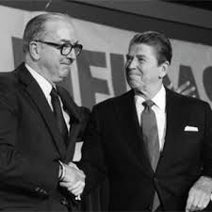
Voices of Homophobia: Jesse Helms, Republican of North Carolina, “Senator No”
In the 1970s and 1980s, Senator Jesse Helms, conservative Republican of North Carolina, was known as “Senator No.”
Transparently homophobic, Helms led Senate opposition to proposals in Congress to provide federal funds to combat the AIDS epidemic.
According to his obituary in The New York Times in 2008, Sen. Helms “fought bitterly against federal financing for AIDS research and treatment, saying the disease resulted from ‘unnatural’ and ‘disgusting’ homosexual behavior.”
Senator Helms and President Reagan, date unknown

Slide 16
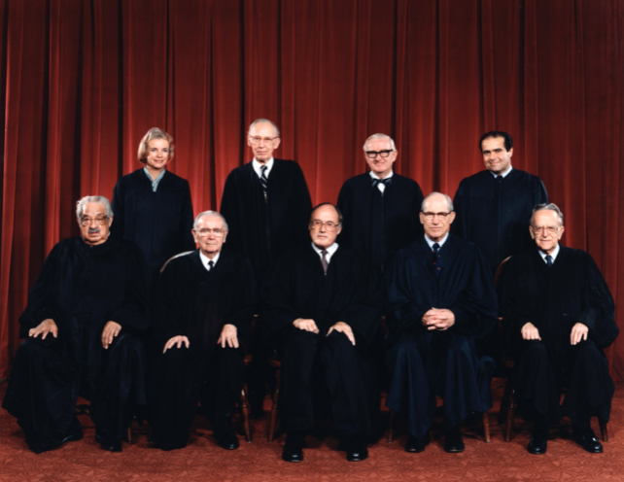
The United States Supreme Court and Gay Civil Rights
The Rehnquist Supreme Court 1986-1987
During the Reagan presidency, the Supreme Court decided no cases concerning the AIDS epidemic. However, Justice Anthony Kennedy, a Reagan appointee who joined the Court in early 1988, later wrote the majority opinions in several landmark gay rights cases before retiring in 2017.

Slide 17
Was President Reagan’s Health in Decline in 1989?
Critics whispered that some of President Reagan’s problems during his second term, from the Iran-Contra scandal to his administration’s continuing slow response to the AIDS epidemic, were caused by
advancing age and, possibly, declining mental health. However, he appeared to be well in this photograph,
taken fewer than 10 days before he left office.

Slide 18
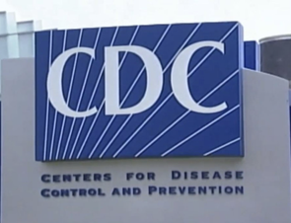
The AIDS Death Count in the United States, 1981-1989, and the American Government’s Response
By the time President Reagan left office on January 20, 1989, nearly 100,000 Americans had died from AIDS.
Federal spending to combat the AIDS epidemic began in 1981 and 1982, even before the disease had a name, but critics always asserted much more could have been done.
According to the Centers for Disease Control: “In 1985, the first federal resources dedicated to HIV prevention were made available to all state and local health departments nationwide. In 1987, a national effort to educate the public about HIV and AIDS was launched and CDC created a comprehensive AIDS information resource, the CDC National AIDS Hotline and National AIDS Information Clearinghouse. Comprehensive school-based HIV education to inform and educate young persons began in 1987, and funding for national, regional, and community-based organizations began in 1988.”

Slide 19
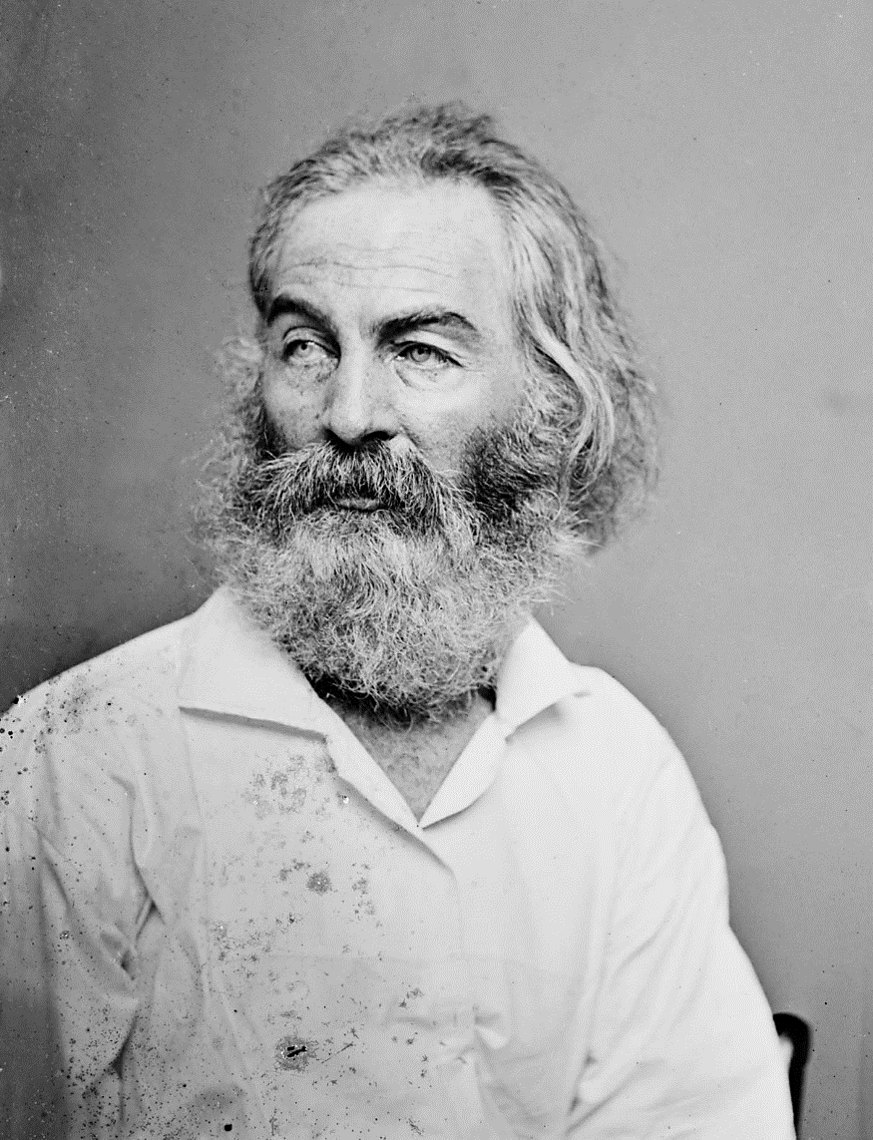
Walt Whitman’s Lament
Walt Whitman, the great Civil War-era poet of democracy, wrote eloquently about the young men who died on the battlefields and whom he attended as a volunteer at hospitals in Washington. In a poem, Whitman lamented “The Dead, the Dead, the Dead”.
Whitman died in 1892 and is buried in Camden, New Jersey, fewer than 100 miles from New York City, where he lived at one time and so many men died from AIDS in the 1980s and after.
Throughout the AIDS epidemic, Walt Whitman wept.

Slide 20
Randy Shilts (1951 – 1994)
Randy Shilts was a journalist who covered the AIDS epidemic from its earliest days for the San Francisco Chronicle.
This book was originally published in 1987, while President Reagan was still in office, and became a international bestseller. In 1993, it was the principal source for a critically-acclaimed television docudrama.
Shilts died from AIDS in 1994.

Slide 21
Selective Bibliography
Brands, H.W., Reagan: The Life (Anchor, reprint edition, paperback, 2016)
Cannon, Lou, President Reagan: The Role of a Lifetime (PublicAffairs, rev. sub. ed., paperback, 2000)
Engel, Jonathan, The Epidemic: A Global History of AIDS (HarperCollins, paperback, 2006)
Francis, Donald P. “Commentary: Deadly AIDS Policy Failure by the Highest Levels of the US Government: A Personal Look Back 30 Years Later for Lessons to Respond Better to Future Epidemics.” Journal of Public Health Policy, vol. 33, no. 3, 2012, pp. 290–300. JSTOR, www.jstor.org/stable/23253449
Greenstein, Fred I., The Presidential Difference: Leadership Style from FDR to Barack Obama (Princeton UP, third edition, paperback, 2009)
Harden, Victoria A., AIDS at 30: A History (Potomac Books, 2012)
Hayward, Steven F., The Age of Reagan: The Conservative Counterrevolution: 1980-1989 (Crown Forum, reprint ed., paperback, 2010)
Jacobs, Meg & Julian E. Zelizer, eds., Conservatives in Power: The Reagan Years, 1981-1989, A Brief History with Documents (Bedford/St. Martins, paperback, 2011)
Neustadt, Richard E., Presidential Power and the Modern Presidents: The Politics of Leadership from Roosevelt to Reagan (Free Press, revised ed., paperback, 1991)
Patterson, James T., Restless Giant: The United States from Watergate to Bush v. Gore (Oxford UP, paperback, 2007)
Reagan, Ronald, An American Life (Threshold Editions, reprint edition, paperback, 2011)
Reeves, Richard, President Reagan: The Triumph of Imagination (Simon & Schuster, paperback, 2006)

Slide 22
Selective Bibliography, Continued
Richert, Lucas, “Reagan, Regulation, and the FDA: The US Food and Drug Administration's Response to HIV/AIDS, 1980-90”, Canadian Joumat of History/Annales canadiennes d’histoire, XLIV, winter/hiver 2009, pp. 467^87, ISSN 0-008^1107 O, Canadian Journal of History, available in EBSCOhost, Academic Search Premier database
Rossinow, Doug, The Reagan Era: A History of the 1980s (Columbia UP, paperback, 2016)
Schaller, Michael, Reckoning with Reagan: America and Its President in the 1980s (Oxford UP, paperback, 1994)
Shilts, Randy, And the Band Played On: Politics, People, and the AIDS Epidemic (1987, St. Martin's Griffin; revised edition, paperback, 2007)
Weisberg, Jacob, Ronald Reagan: The American Presidents Series; The 40th President, 1981-1989 (Times Books, 2016)
Wilentz, Sean, The Age of Reagan: A History, 1974-2008 (Harper Perennial, reprint edition, paperback, 2009)

